Slide 1
Project CASA: Final Project Presentation
May 25, 2017
Yevgeniya Chekh, Jan Kohout, David Löffler, Miroslav Rudišin, Kryštof Sýkora, Marek Szeles, Ho Minh Thanh

Slide 2
Presentation agenda
Introduction, what is CASA?
Review formal project outputs
Project run overview
Lessons learned, individual reviews

Slide 3
Who are we?
Team Role | Name | Contact
Project Lead | Marek Szeles | szelemar@fel.cvut.cz
Analyst | Ho Minh Thanh | homintha@fel.cvut.cz
Head of Development | David Löffler | loffldav@fel.cvut.cz
Head of Testing | Kryštof Sýkora | sykorkry@fel.cvut.cz
Developer | Miroslav Rudišin | rudismi1@fel.cvut.cz
Developer | Jan Kohout | kohouj13@fel.cvut.cz
Tester | Yevgeniya Chekh | chekhyev@fel.cvut.cz

Slide 4
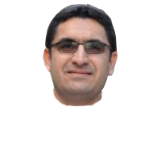
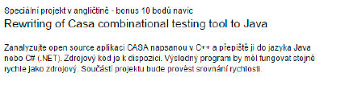
What is CASA?
Dr. Bestoun S. Ahmed 

Slide 5
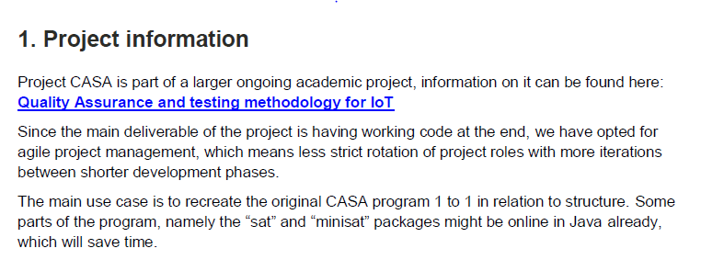
What is CASA?
Dr. Bestoun S. Ahmed 

Slide 6
So… Is CASA a success?
Yes!
No!
Jein?!

Slide 7
Why?
Meetings: 16
Steering Workshops held: 5 (so far)
3 Presentations (excluding this one)
Documents created: 28
Spanning over: 118 pages
Lines of code worked on: 323 198

Slide 8
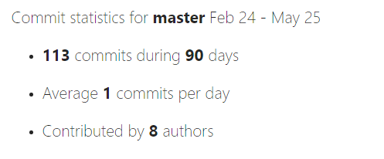
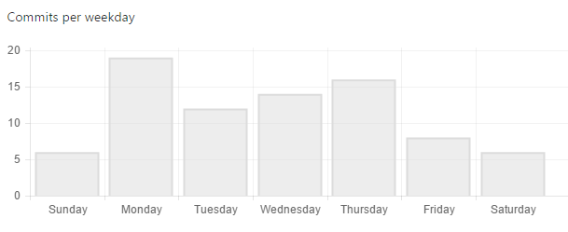
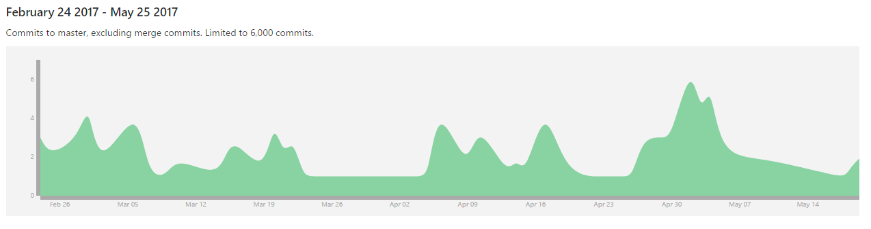
Also why?

Slide 9
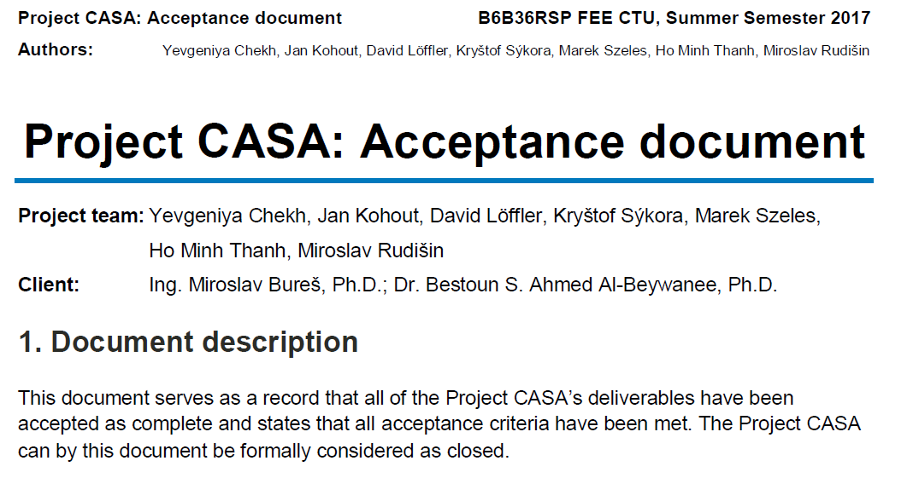
And finally…

Slide 10
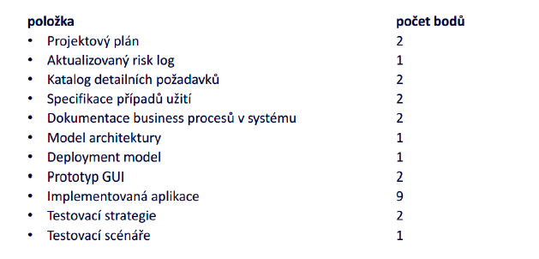
Let‘s take a look at the official rules though:
1
2
3
4
5
6
7
8
9
10
11

Slide 11
Let‘s take a look at the official rules though:
1
2
3
4
5
6
7
8
9
10
11

Slide 12
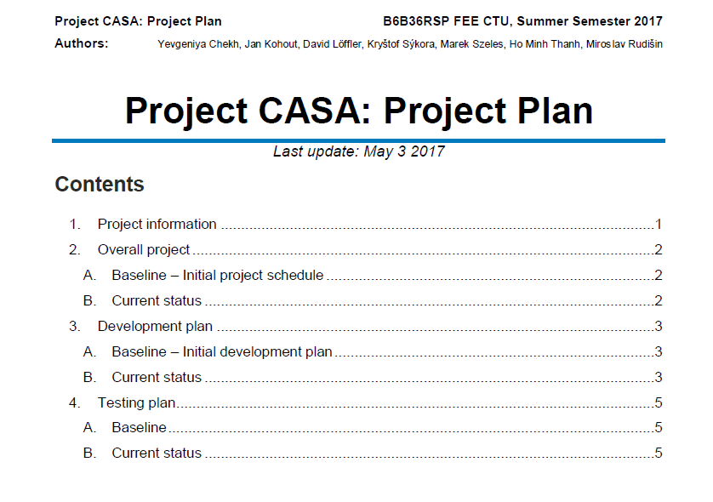
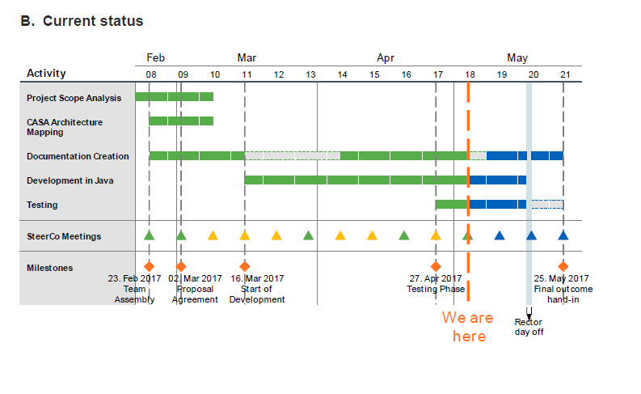
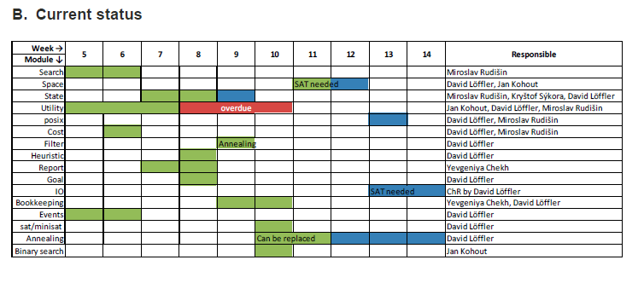
Project plan
Completed
1

Slide 13
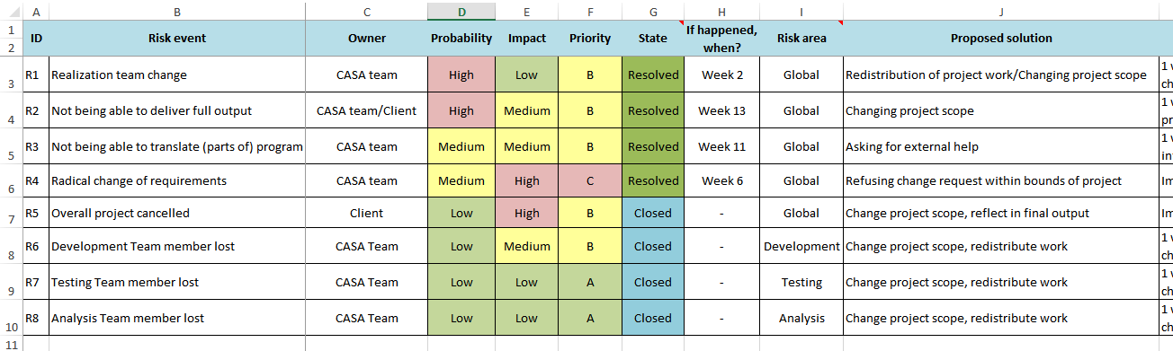
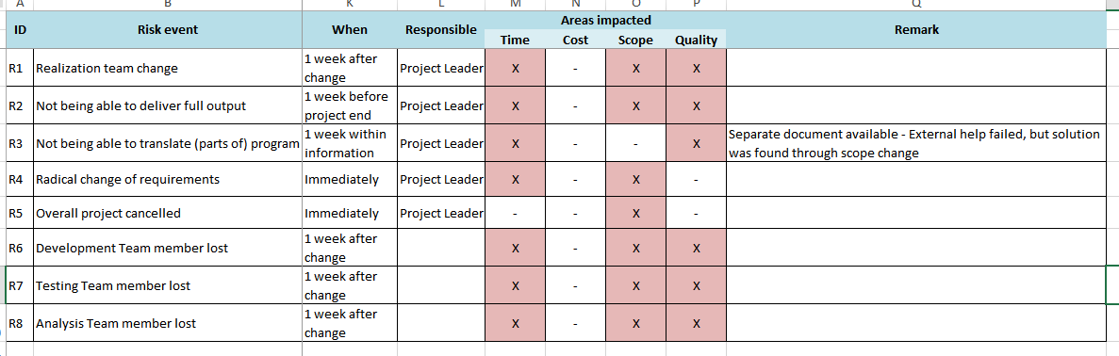
Risk log
Completed
2

Slide 14
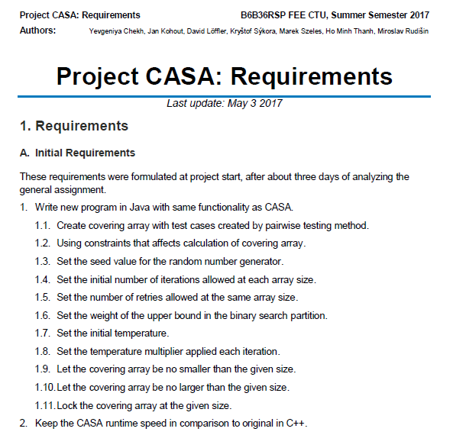
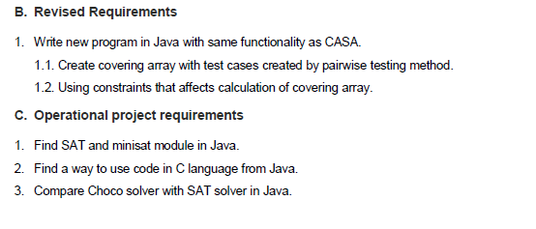
Detailed requirements specification
Completed
3

Slide 15
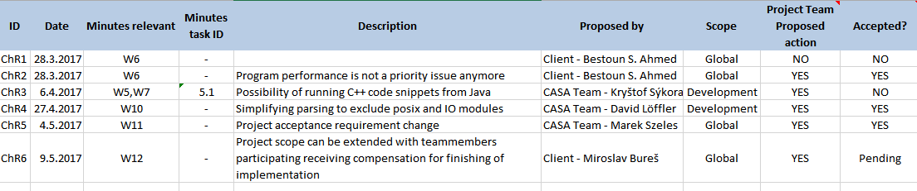
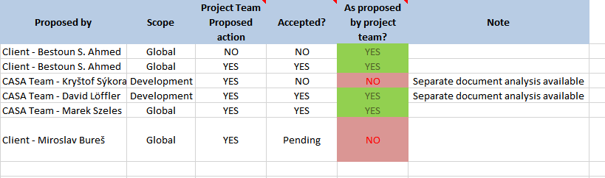
Bonus – Change requests
Completed
3

Slide 16
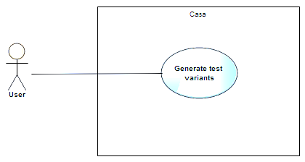
Use case specification (1/3)
Completed
4

Slide 17
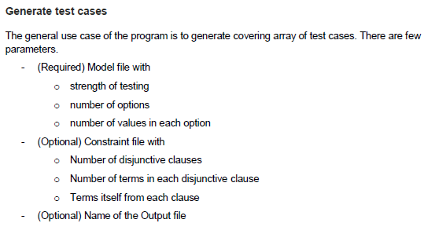
Use case specification (2/3)
Completed
4

Slide 18
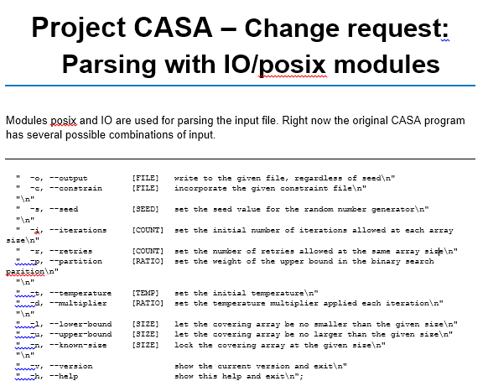
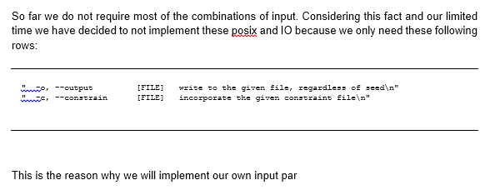
Use case specification (3/3) – ChR4
Completed
4

Slide 19

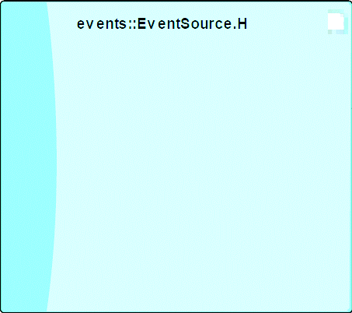
Architecture model v1
Completed
6
Legend
Header file
C file
Dependency

Slide 20
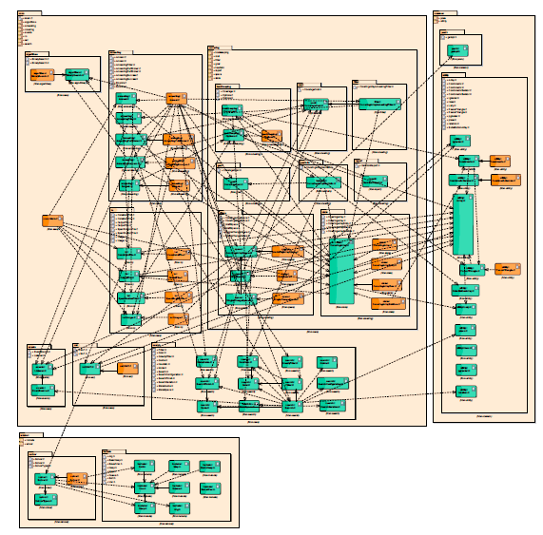
Architecture model v2
Completed
6
Legend
Header file
C file
Dependency

Slide 21
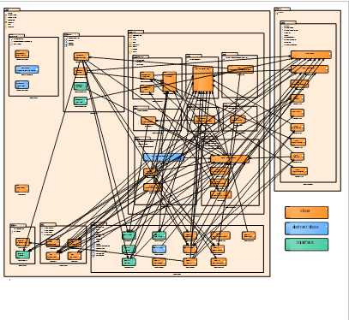
Architecture model v3 – Java
Completed
6
Legend
Class
Abstract class
Interface
Dependency

Slide 22
Deployment model
Completed
7

Slide 23
Application – Acceptance + Change of scope
Change of scope
9
Accepted current result, next steps TBD

Slide 24
Business processes; GUI; Testing strategy: Out of project scope/other solution
Out of scope
5
8
10
11
Not relevant for project
(accepted)

Slide 25
Project plan - expectation
Feb
Mar
Apr
May
Activity
08
09
10
11
12
13
14
15
16
17
18
19
20
21
Project Scope Analysis
CASA Architecture Mapping
Documentation Creation
Development in Java
Testing
SteerCo Meetings
Milestones
23. Feb 2017
Team Assembly
02. Mar 2017
Proposal Agreement
16. Mar 2017
Start of
Development
27. Apr 2017
Testing Phase
25. May 2017
Final outcome
hand-in
Rector day off

Slide 26
Project plan - reality
Feb
Mar
Apr
May
Activity
08
09
10
11
12
13
14
15
16
17
18
19
20
21
Project Scope Analysis
CASA Architecture Mapping
Documentation Creation
Development in Java
Testing
SteerCo Meetings
26. May 2017
Project formal
finish
Milestones
23. Feb 2017
Team Assembly
02. Mar 2017
Proposal Agreement
16. Mar 2017
Start of
Development
27. Apr 2017
Testing Phase
Risk
triggered
Mitigation
We are
here
Rector day off

Slide 27
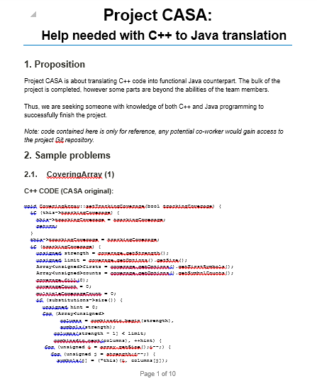
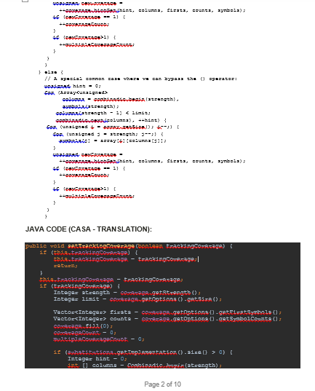
Critical moment: Development stall >Risk management with project sponsor

Slide 28
Risk management failed > Change of scope
Project scope change

Slide 29
Deep Dive: Analytics

Slide 30
Analysis – What are we doing?
First step: Read the documentation - success
Second step: Understand the documentation – failed
Third step: Ask Bestoun S. Ahmed - success

Slide 31
Analysis - Full Project View
1
2.1
2
1.1
1.2
2.2
1.3
1.5
1.4
Legend
1.7
Header file
1.6
C file
3
Dependency
3.1
3.2

Slide 32
Analysis – We don‘t want to reinvent wheels.
What modules can we run in C++? – None
Are there modules in Java we can use? – Yes, SAT

Slide 33
Deep Dive: Development

Slide 34
Development progress
Starting with package with least dependencies
CASA
1
3
1
2
casa
2
3
common
minisat
1.1
1.1
1.5
1.5
2.1
2.1
3.1
algorithms
io
posix
3.1
solver
1.2
1.2
1.6
1.6
2.2
2.2
3.2
annealing
sat
utility
3.2
include
1.3
1.7
1.3
1.7
covering
search
1.4
1.4
events
Main.C

Slide 35
Full Project View: Starting point
1
2.1
2
1.1
1.2
2.2
1.3
1.5
1.4
Legend
Not started
1.7
1.6
In progress
3
Finished
3.1
3.2
Change request

Slide 36
Full Project View: 16.3.2017
1
2.1
2
1.1
1.2
2.2
1.3
1.5
1.4
Legend
Not started
1.7
1.6
In progress
3
Finished
3.1
3.2
Change request

Slide 37
Full Project View: 20.4.2017
1
2.1
2
1.1
1.2
2.2
1.3
1.5
1.4
Legend
Not started
1.7
1.6
In progress
3
Finished
3.1
3.2
Change request

Slide 38
Full Project View: 4.5.2017
1
2.1
2
1.1
1.2
2.2
1.3
1.5
1.4
Legend
Not started
1.7
1.6
In progress
3
Finished
3.1
3.2
Change request

Slide 39
Full Project View: Current status
1
2.1
2
1.1
1.2
2.2
1.3
1.5
1.4
Legend
Not started
1.7
1.6
In progress
3
Finished
3.1
3.2
Change request

Slide 40
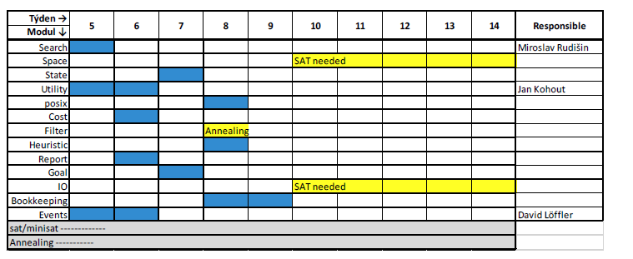
Development plan:

Slide 41
Development plan - reality:
Week → | 5 | 6 | 7 | 8 | 9 | 10 | 11 | 12 | 13 | 14 | Responsible
Module ↓
Search |  |  |  |  |  |  |  |  |  |  | Miroslav Rudišin
Space |  |  |  |  |  |  | SAT needed |  |  |  | David Löffler, Jan Kohout
State |  |  |  |  |  |  |  |  |  |  | Miroslav Rudišin, Kryštof Sýkora, David Löffler
Utility |  |  |  | overdue |  |  |  |  |  |  | Jan Kohout, David Löffler, Miroslav Rudišin
posix |  |  |  |  |  |  |  |  |  |  | David Löffler, Miroslav Rudišin
Cost |  |  |  |  |  |  |  |  |  |  | David Löffler, Miroslav Rudišin
Filter |  |  |  |  | Annealing |  |  |  |  |  | David Löffler
Heuristic |  |  |  |  |  |  |  |  |  |  | David Löffler
Report |  |  |  |  |  |  |  |  |  |  | Yevgeniya Chekh
Goal |  |  |  |  |  |  |  |  |  |  | David Löffler
IO |  |  |  |  |  |  |  |  | SAT needed |  | ChR by David Löffler
Bookkeeping |  |  |  |  |  |  |  |  |  |  | Yevgeniya Chekh, David Löffler
Events |  |  |  |  |  |  |  |  |  |  | David Löffler
sat/minisat |  |  |  |  |  |  |  |  |  |  | David Löffler
Annealing |  |  |  |  |  | Can be replaced |  |  |  |  | David Löffler
Binary search |  |  |  |  |  |  |  |  |  |  | Jan Kohout

Slide 42
Deep Dive: Testing

Slide 43
Testing
Input x output comparison
Unit testing for development support
Complications:
Could not build system
Unable to test beyond a certain degree of focus
Further testing and strategies

Slide 44
Unit testing overview (4.5. 2017)
1
2.1
2
1.1
1.2
2.2
1.3
1.5
1.4
Legend
Not started
1.7
1.6
In progress
3
Finished
3.1
3.2
Change request

Slide 45
Final individual reviews, Lessons learned

Slide 46
Project evaluation: Marek Szeles
Team Role | Name | Contact
Project Lead | Marek Szeles | szelemar@fel.cvut.cz
Analyst | Ho Minh Thanh | homintha@fel.cvut.cz
Head of Development | David Löffler | loffldav@fel.cvut.cz
Head of Testing | Kryštof Sýkora | sykorkry@fel.cvut.cz
Developer | Miroslav Rudišin | rudismi1@fel.cvut.cz
Developer | Jan Kohout | kohouj13@fel.cvut.cz
Tester | Yevgeniya Chekh | chekhyev@fel.cvut.cz

Slide 47
Project evaluation: Ho Minh Thanh
Team Role | Name | Contact
Project Lead | Marek Szeles | szelemar@fel.cvut.cz
Analyst | Ho Minh Thanh | homintha@fel.cvut.cz
Head of Development | David Löffler | loffldav@fel.cvut.cz
Head of Testing | Kryštof Sýkora | sykorkry@fel.cvut.cz
Developer | Miroslav Rudišin | rudismi1@fel.cvut.cz
Developer | Jan Kohout | kohouj13@fel.cvut.cz
Tester | Yevgeniya Chekh | chekhyev@fel.cvut.cz

Slide 48
Project evaluation: David Löffler
Team Role | Name | Contact
Project Lead | Marek Szeles | szelemar@fel.cvut.cz
Analyst | Ho Minh Thanh | homintha@fel.cvut.cz
Head of Development | David Löffler | loffldav@fel.cvut.cz
Head of Testing | Kryštof Sýkora | sykorkry@fel.cvut.cz
Developer | Miroslav Rudišin | rudismi1@fel.cvut.cz
Developer | Jan Kohout | kohouj13@fel.cvut.cz
Tester | Yevgeniya Chekh | chekhyev@fel.cvut.cz

Slide 49
Project evaluation: Kryštof Sýkora
Team Role | Name | Contact
Project Lead | Marek Szeles | szelemar@fel.cvut.cz
Analyst | Ho Minh Thanh | homintha@fel.cvut.cz
Head of Development | David Löffler | loffldav@fel.cvut.cz
Head of Testing | Kryštof Sýkora | sykorkry@fel.cvut.cz
Developer | Miroslav Rudišin | rudismi1@fel.cvut.cz
Developer | Jan Kohout | kohouj13@fel.cvut.cz
Tester | Yevgeniya Chekh | chekhyev@fel.cvut.cz

Slide 50
Project evaluation: Miroslav Rudišin
Team Role | Name | Contact
Project Lead | Marek Szeles | szelemar@fel.cvut.cz
Analyst | Ho Minh Thanh | homintha@fel.cvut.cz
Head of Development | David Löffler | loffldav@fel.cvut.cz
Head of Testing | Kryštof Sýkora | sykorkry@fel.cvut.cz
Developer | Miroslav Rudišin | rudismi1@fel.cvut.cz
Developer | Jan Kohout | kohouj13@fel.cvut.cz
Tester | Yevgeniya Chekh | chekhyev@fel.cvut.cz

Slide 51
Project evaluation: Jan Kohout
Team Role | Name | Contact
Project Lead | Marek Szeles | szelemar@fel.cvut.cz
Analyst | Ho Minh Thanh | homintha@fel.cvut.cz
Head of Development | David Löffler | loffldav@fel.cvut.cz
Head of Testing | Kryštof Sýkora | sykorkry@fel.cvut.cz
Developer | Miroslav Rudišin | rudismi1@fel.cvut.cz
Developer | Jan Kohout | kohouj13@fel.cvut.cz
Tester | Yevgeniya Chekh | chekhyev@fel.cvut.cz

Slide 52
Project evaluation: Yevgeniya Chekh
Team Role | Name | Contact
Project Lead | Marek Szeles | szelemar@fel.cvut.cz
Analyst | Ho Minh Thanh | homintha@fel.cvut.cz
Head of Development | David Löffler | loffldav@fel.cvut.cz
Head of Testing | Kryštof Sýkora | sykorkry@fel.cvut.cz
Developer | Miroslav Rudišin | rudismi1@fel.cvut.cz
Developer | Jan Kohout | kohouj13@fel.cvut.cz
Tester | Yevgeniya Chekh | chekhyev@fel.cvut.cz

Slide 53
Lessons learned
Communication is key
Change requests by client are chaotic > gotta own the problem
Even the best analysis sometimes is not good enough
Even the best risk management sometimes does not help
It helps to have someone dedicated to information management

Slide 54
Points distribution
Team Role | Name | Points
Project Lead | Marek Szeles | 25
Analyst | Ho Minh Thanh | 25
Head of Development | David Löffler | 25
Head of Testing | Kryštof Sýkora | 25
Developer | Miroslav Rudišin | 20
Developer | Jan Kohout | 25
Tester | Yevgeniya Chekh | 25

Slide 55

Otázky, návrhy…
Thank you for your attention.
Do you have
questions?

